Slide 1


Intelligent Traffic Management System on NVIDIA Jetson Nano
CS22B016 Chatse Siddhant
CS22B024 Harshit Garg
Under Guidance of Dr. Jayanarayan T Tudu

Slide 2


Background
Rapid urbanization and increasing vehicle density have made traffic congestion a major challenge in modern cities. However, most traffic signals still operate using fixed-time control, without considering real-time traffic conditions.
Problems with Current Traffic Systems :
Fixed-time traffic signals
No real-time awareness of traffic
Inefficient under variable congestion
High delays and frequent congestion
Treat all traffic scenarios the same

Slide 3
Related Work
Existing Solutions :
Inductive loop sensors
Infrared / radar sensors
GPS-based congestion estimation
Manual CCTV monitoring
Problems with Existing Approaches :
High cost and maintenance
Poor scalability
Not adaptive
Unsuitable for Indian traffic diversity

Slide 4
Problem Statement
Design a real-time, vision-based traffic signal control system that dynamically assigns green signals based on actual lane congestion while ensuring fairness and avoiding lane starvation.
Constraints :
Deployment on Jetson Nano
Real-time execution
Must work under Indian traffic conditions
Fair signal distribution

Slide 5
Motivation
Our motivation was to design a system that understands actual road conditions instead of following rigid timers. With the availability of CCTV cameras and edge devices like Jetson Nano, computer vision becomes a practical solution.
This will result in
Reduce unnecessary waiting time
Improve junction throughput
Prevent starvation of low-traffic lanes
Foundation for emergency vehicle priority (such as Ambulance, Fire Brigade)

Slide 6
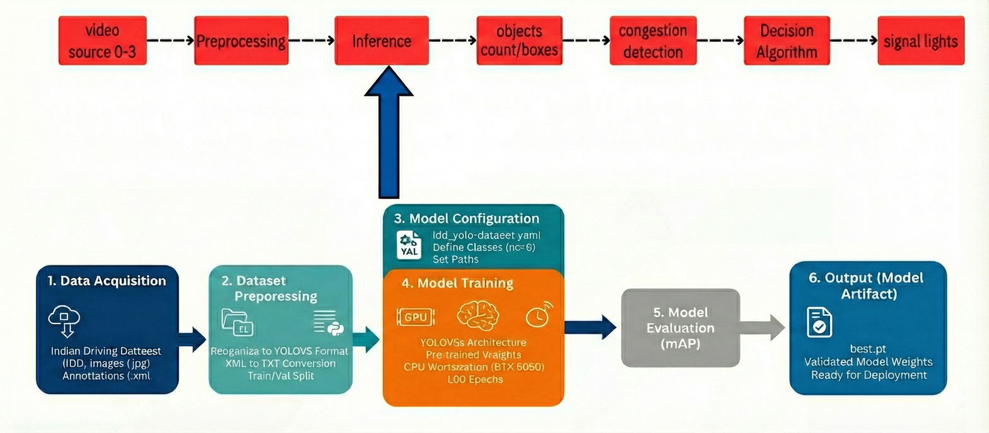
Approach
We propose a real-time, vision-based framework designed to adapt traffic signals using lane-wise congestion and waiting time. The approach prioritizes fairness, efficiency, and deployability on edge hardware.
High-Level Pipeline :
Multi-lane video input (4 lanes)
Real-time vehicle detection
Lane-wise congestion estimation
Fair signal decision logic
Time-synchronized signal switching
Real-time visualization

Slide 7
Object Detection Model
We fine-tuned YOLOv5 specifically for Indian roads instead of using generic datasets, which significantly improves detection reliability.
Object Detection :
YOLOv5s (fine-tuned)
Trained on Indian Driving Dataset (IDD)
Classes: car, autorickshaw, truck, motorcycle, bus
Why YOLOv5s :
High speed
Good accuracy
Suitable for real-time edge inference

Slide 8
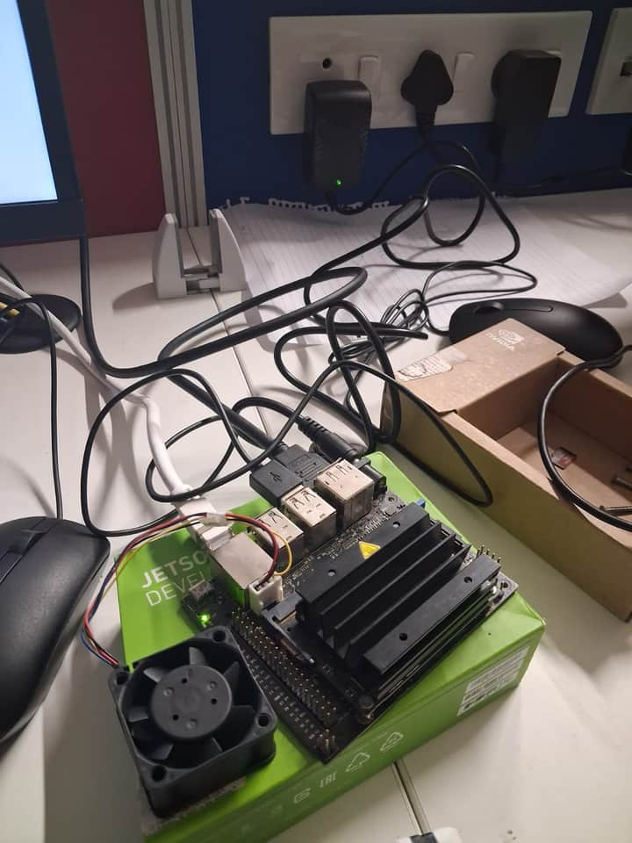
Deployment & Optimization
To achieve real-time performance on Jetson Nano, we exported the model to ONNX and then built a TensorRT engine.
PyTorch is slow on edge devices
ONNX provides portability
TensorRT enables:
FP16 inference
Memory optimization
3×–5× SpeedUp
Jetson Nano

Slide 9
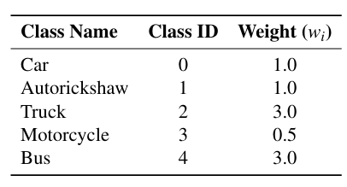
Congestion Estimation & Signal Logic
Instead of giving green based only on vehicle count, we include waiting time so that no lane remains blocked indefinitely.
Congestion = ∑ Weight
Wait Time = Time elapsed since lane last received a green signal
Signal Decision
Effective Score= (0.7 × Congestion) + (0.3 × Wait Time)
Prevents lane starvation
Decisions every 15 seconds
lane with the maximum effective score is selected to receive the green signal

Slide 10
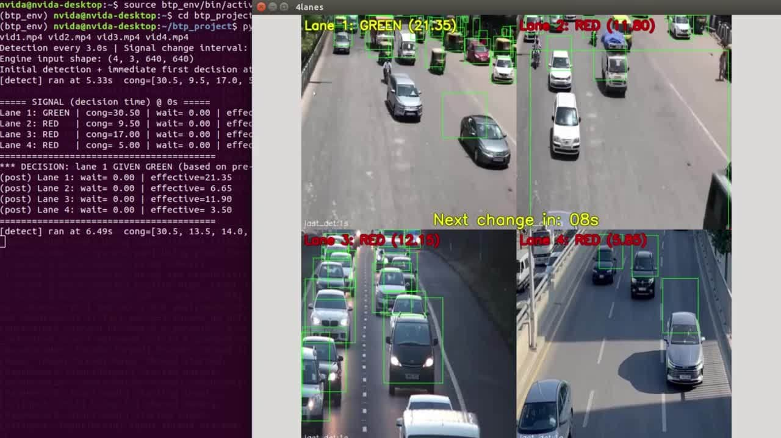
Demonstration

Slide 11
Current Status
As of now, the complete software pipeline is stable and real-time ready.
Model trained and validated
TensorRT deployment complete
Multi-lane real-time inference working
Fair signal logic implemented
Visualization and debugging tools complete

Slide 12
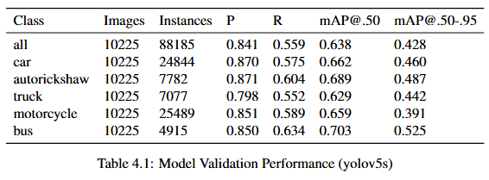
Results
Precision (P): How many detected vehicles are actually correct.
Recall (R): How many real vehicles were successfully detected.
mAP@0.50: Overall detection accuracy at IoU (Intersection over Union) ≥ 50%.
mAP@0.50–0.95: Stricter accuracy over multiple IoU thresholds.
The model achieves high overall precision (0.841), making detections reliable for congestion estimation.
mAP@0.50 of 0.638 confirms strong detection capability under diverse Indian traffic conditions.
Heavy vehicles such as buses and trucks show good recall, which is critical as they significantly affect traffic flow.
High precision ensures congestion is not overestimated, which is crucial for correct signal decisions.

Slide 13
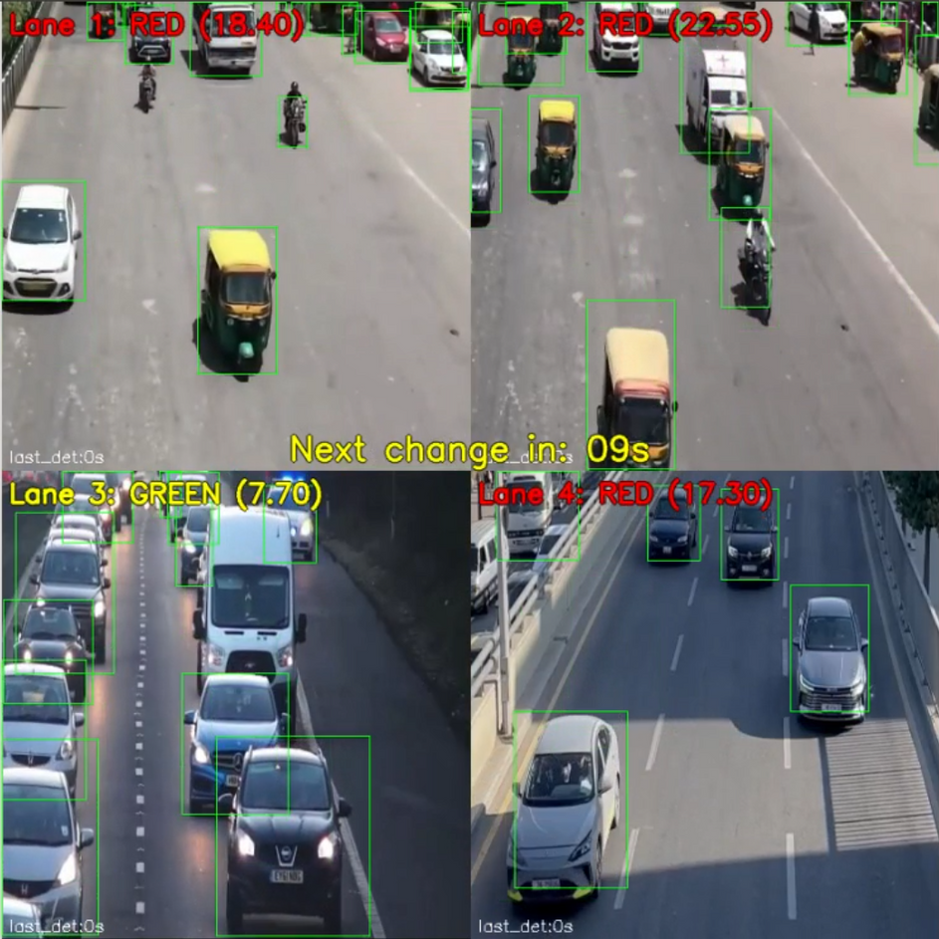
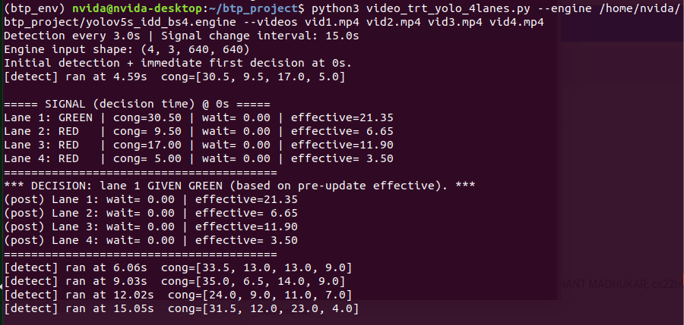
Results
Real-time 4-lane visualization
Lane-wise congestion estimation
Green signal allocation based on effective congestion score
Countdown timer for signal change
Console logs validate transparent and explainable decision-making

Slide 14
Contributions
Siddhant
Finetuned YOLOv5s object detection model on the Indian Driving Dataset (IDD)
Implemented TensorRT engine conversion and optimized real-time inference on Jetson Nano
Designed lane wise weighted congestion estimation for heterogeneous traffic
Developed wait-time aware signal decision logic to prevent lane starvation
Integrated real-time visualization, countdown timer, and signal state display
Harshit
Performed dataset preprocessing and annotation conversion (XML → YOLO format)
Conducted model training, validation, and detailed performance analysis (P, R, mAP)
Designed mathematical formulation for congestion and effective score computation
Implemented synchronized signal scheduling with minimum green-time constraints
Assisted in system testing, debugging, documentation, and report preparation

Slide 15

Thank You

